Slide 1
Chapter 9
Subprograms

Slide 2
Chapter 9 Topics
Introduction
Fundamentals of Subprograms
Design Issues for Subprograms
Local Referencing Environments
Parameter-Passing Methods
Parameters That Are Subprograms
Overloaded Subprograms
Generic Subprograms
Design Issues for Functions
User-Defined Overloaded Operators
Coroutines

Slide 3
Introduction
Two fundamental abstraction facilities
  Process abstraction
    Emphasized from early days
  Data abstraction
    Emphasized in the1980s

Slide 4
Fundamentals of Subprograms
Each subprogram has a single entry point
The calling program is suspended during execution of the called subprogram
Control always returns to the caller when the called subprogram’s execution terminates

Slide 5
Basic Definitions
A subprogram definition describes the interface to and the actions of the subprogram abstraction
- In Python, function definitions are executable; in
all other languages, they are non-executable
A subprogram call is an explicit request that the subprogram be executed
A subprogram header is the first part of the definition, including the name, the kind of subprogram, and the formal parameters
The parameter profile (aka signature) of a subprogram is the number, order, and types of its parameters
The protocol is a subprogram’s parameter profile and, if it is a function, its return type

Slide 6
Basic Definitions (continued)
Function declarations in C and C++ are often called prototypes
A subprogram declaration provides the protocol, but not the body, of the subprogram
A formal parameter is a dummy variable listed in the subprogram header and used in the subprogram
An actual parameter represents a value or address used in the subprogram call statement

Slide 7
Actual/Formal Parameter Correspondence
Positional
  The binding of actual parameters to formal parameters is by position: the first actual parameter is bound to the first formal parameter and so forth
  Safe and effective
Keyword
  The name of the formal parameter to which an actual parameter is to be bound is specified with the actual parameter
  Advantage: Parameters can appear in any order, thereby avoiding parameter correspondence errors
  Disadvantage: User must know the formal parameter’s names

Slide 8
Formal Parameter Default Values
In certain languages (e.g., C++, Python, Ruby, Ada, PHP), formal parameters can have default values (if no actual parameter is passed)
  In C++, default parameters must appear last because parameters are positionally associated
Variable numbers of parameters
- C# methods can accept a variable number of parameters as long as they are of the same type—the corresponding formal parameter is an array preceded by params
- Ruby and Python also support variable numbers of parameters. In Ruby, the actual parameters are sent as elements of a hash literal and the corresponding formal parameter is preceded by an asterisk.
- In Python, the actual is a list of values and the corresponding formal parameter is a name with an asterisk

Slide 9
Ruby Blocks
Ruby includes a number of iterator functions, which are often used to process the elements of arrays
Iterators are implemented with blocks, which can also be defined by applications
Blocks are attached methods calls; they can have parameters (in vertical bars); they are executed when the method executes a yield statement
def fibonacci(last)
first, second = 1, 1
while first <= last
yield first
first, second = second, first + second
end
end
puts "Fibonacci numbers less than 100 are:"
fibonacci(100) {|num| print num, " "}
puts

Slide 10
Procedures and Functions
There are two categories of subprograms
  Procedures are collection of statements that define parameterized computations
  Functions structurally resemble procedures but are semantically modeled on mathematical functions
    They are expected to produce no side effects
    In practice, program functions have side effects

Slide 11
Design Issues for Subprograms
Are local variables static or dynamic?
Can subprogram definitions appear in other subprogram definitions?
What parameter passing methods are provided?
Are parameter types checked?
If subprograms can be passed as parameters and subprograms can be nested, what is the referencing environment of a passed subprogram?
Can subprograms be overloaded?
Can subprogram be generic?

Slide 12
Local Referencing Environments
Local variables can be stack-dynamic
- Advantages
    Support for recursion
    Storage for locals is shared among some subprograms
  Disadvantages
    Allocation/de-allocation, initialization time
    Indirect addressing
    Subprograms cannot be history sensitive
Local variables can be static
  Advantages and disadvantages are the opposite of those for stack-dynamic local variables

Slide 13
Semantic Models of Parameter Passing
In mode
Out mode
Inout mode

Slide 14
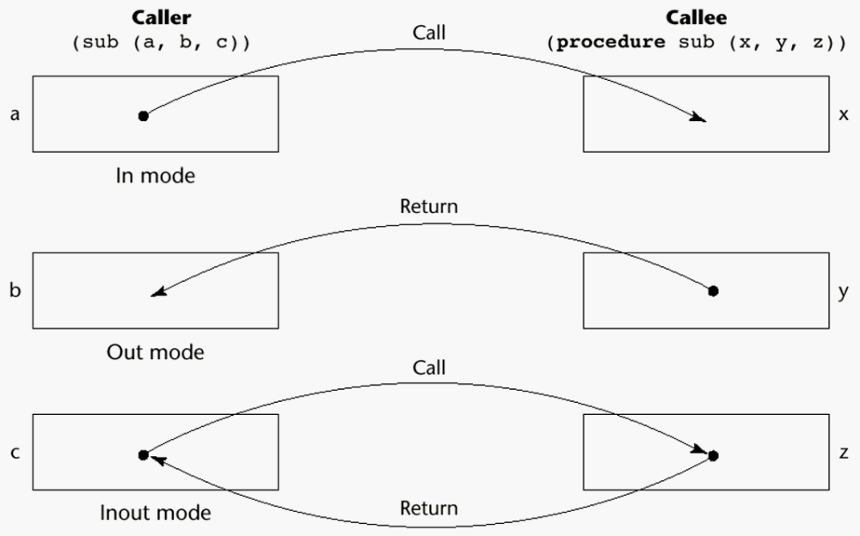
Models of Parameter Passing

Slide 15
Conceptual Models of Transfer
Physically move a path
Move an access path

Slide 16
Pass-by-Value (In Mode)
The value of the actual parameter is used to initialize the corresponding formal parameter
  Normally implemented by copying
  Can be implemented by transmitting an access path but not recommended (enforcing write protection is not easy)
  Disadvantages (if by physical move): additional storage is required (stored twice) and the actual move can be costly (for large parameters)
  Disadvantages (if by access path method): must write-protect in the called subprogram and accesses cost more (indirect addressing)

Slide 17
Pass-by-Result (Out Mode)
When a parameter is passed by result, no value is transmitted to the subprogram; the corresponding formal parameter acts as a local variable; its value is transmitted to caller’s actual parameter when control is returned to the caller, by physical move
  Require extra storage location and copy operation
Potential problem: sub(p1, p1); whichever formal parameter is copied back will represent the current value of p1

Slide 18
Pass-by-Value-Result (inout Mode)
A combination of pass-by-value and pass-by-result
Sometimes called pass-by-copy
Formal parameters have local storage
Disadvantages:
  Those of pass-by-result
  Those of pass-by-value

Slide 19
Pass-by-Reference (Inout Mode)
Pass an access path
Also called pass-by-sharing
Advantage: Passing process is efficient (no copying and no duplicated storage)
Disadvantages
  Slower accesses (compared to pass-by-value) to formal parameters
  Potentials for unwanted side effects (collisions)
  Unwanted aliases (access broadened)

Slide 20
Pass-by-Name (Inout Mode)
By textual substitution
Formals are bound to an access method at the time of the call, but actual binding to a value or address takes place at the time of a reference or assignment
Allows flexibility in late binding

Slide 21
Implementing Parameter-Passing Methods
In most language parameter communication takes place thru the run-time stack
Pass-by-reference are the simplest to implement; only an address is placed in the stack
A subtle but fatal error can occur with pass-by-reference and pass-by-value-result: a formal parameter corresponding to a constant can mistakenly be changed

Slide 22
Parameter Passing Methods of Major Languages
C
  Pass-by-value
  Pass-by-reference is achieved by using pointers as parameters
C++
  A special pointer type called reference type for pass-by-reference
Java
  All parameters are passed by value
  Object parameters are passed by reference
Ada
  Three semantics modes of parameter transmission: in, out, in out; in is the default mode
  Formal parameters declared out can be assigned but not referenced; those declared in can be referenced but not assigned; in out parameters can be referenced and assigned

Slide 23
Parameter Passing Methods of Major Languages (continued)
Fortran 95
- Parameters can be declared to be in, out, or inout mode
C#
- Default method: pass-by-value
  Pass-by-reference is specified by preceding both a formal parameter and its actual parameter with ref
PHP: very similar to C#
Perl: all actual parameters are implicitly placed in a predefined array named @_
Python and Ruby use pass-by-assignment (all data values are objects)

Slide 24
Type Checking Parameters
Considered very important for reliability
FORTRAN 77 and original C: none
Pascal, FORTRAN 90, Java, and Ada: it is always required
ANSI C and C++: choice is made by the user
  Prototypes
Relatively new languages Perl, JavaScript, and PHP do not require type checking
In Python and Ruby, variables do not have types (objects do), so parameter type checking is not possible

Slide 25
Multidimensional Arrays as Parameters
If a multidimensional array is passed to a subprogram and the subprogram is separately compiled, the compiler needs to know the declared size of that array to build the storage mapping function

Slide 26
Multidimensional Arrays as Parameters: C and C++
Programmer is required to include the declared sizes of all but the first subscript (e.g. the no. of columns) in the actual parameter
Disallows writing flexible subprograms
Solution: pass a pointer to the array and the sizes of the dimensions as other parameters; the user must include the storage mapping function in terms of the size parameters

Slide 27
Multidimensional Arrays as Parameters: Ada
Ada – not a problem
  Constrained arrays – size is part of the array’s type
  Unconstrained arrays - declared size is part of the object declaration

Slide 28
Multidimensional Arrays as Parameters: Fortran
Formal parameter that are arrays have a declaration after the header
  For single-dimension arrays, the subscript is irrelevant
  For multidimensional arrays, the sizes are sent as parameters and used in the declaration of the formal parameter, so those variables are used in the storage mapping function

Slide 29
Multidimensional Arrays as Parameters: Java and C#
Similar to Ada
Arrays are objects; they are all single-dimensioned, but the elements can be arrays
Each array inherits a named constant (length in Java, Length in C#) that is set to the length of the array when the array object is created

Slide 30
Design Considerations for Parameter Passing
Two important considerations
  Efficiency
  One-way or two-way data transfer
But the above considerations are in conflict
  Good programming suggest limited access to variables, which means one-way whenever possible
  But pass-by-reference is more efficient to pass structures of significant size

Slide 31
Parameters that are Subprogram Names
It is sometimes convenient to pass subprogram names as parameters
Issues:
  Are parameter types checked?
  What is the correct referencing environment for a subprogram that was sent as a parameter?

Slide 32
Parameters that are Subprogram Names: Parameter Type Checking
C and C++: functions cannot be passed as parameters but pointers to functions can be passed and their types include the types of the parameters, so parameters can be type checked
FORTRAN 95 type checks
Ada does not allow subprogram parameters; an alternative is provided via Ada’s generic facility
Java does not allow method names to be passed as parameters

Slide 33
Parameters that are Subprogram Names: Referencing Environment
Shallow binding: The environment of the call statement that enacts the passed subprogram
- Most natural for dynamic-scoped
languages
Deep binding: The environment of the definition of the passed subprogram
- Most natural for static-scoped languages
Ad hoc binding: The environment of the call statement that passed the subprogram

Slide 34
Overloaded Subprograms
An overloaded subprogram is one that has the same name as another subprogram in the same referencing environment
  Every version of an overloaded subprogram has a unique protocol
C++, Java, C#, and Ada include predefined overloaded subprograms
In Ada, the return type of an overloaded function can be used to disambiguate calls (thus two overloaded functions can have the same parameters)
Ada, Java, C++, and C# allow users to write multiple versions of subprograms with the same name

Slide 35
Generic Subprograms
A generic or polymorphic subprogram takes parameters of different types on different activations
Overloaded subprograms provide ad hoc polymorphism
A subprogram that takes a generic parameter that is used in a type expression that describes the type of the parameters of the subprogram provides parametric polymorphism
- A cheap compile-time substitute for dynamic binding
In Ada, generic subprograms are instantiated explicitly
In C++, they are instantiated implicitly, when the subprogram is named in a call or when its address is taken with the & operator

Slide 36
Generic Subprograms (continued)
Java 5.0
- Differences between generics in Java 5.0 and those of C++ and Ada:
1. Generic parameters in Java 5.0 must be classes
2. Java 5.0 generic methods are instantiated just once as truly generic methods
3. Restrictions can be specified on the range of classes that can be passed to the generic method as generic parameters
4. Wildcard types of generic parameters

Slide 37
Generic Subprograms (continued)
C# 2005
- Supports generic methods that are similar to those of Java 5.0
- One difference: actual type parameters in a call can be omitted if the compiler can infer the unspecified type

Slide 38
Examples of parametric polymorphism: C++
template <class Type>
Type max(Type first, Type second) {
return first > second ? first : second;
}
The above template can be instantiated for any type for which operator > is defined
  int max (int first, int second) {
  return first > second? first : second;
  }

Slide 39
Design Issues for Functions
Are side effects allowed?
  Parameters should always be in-mode to reduce side effect (like Ada)
What types of return values are allowed?
  Most imperative languages restrict the return types
  C allows any type except arrays and functions
  C++ is like C but also allows user-defined types
  Ada subprograms can return any type (but Ada subprograms are not types, so they cannot be returned)
  Java and C# methods can return any type (but because methods are not types, they cannot be returned)
  Python and Ruby treat methods as first-class objects, so they can be returned, as well as any other class

Slide 40
User-Defined Overloaded Operators
Operators can be overloaded in Ada, C++, Python, and Ruby
An Ada example
  function "*" (A,B: in Vec_Type): return Integer is
  Sum: Integer := 0;
  begin
  for Index in A'range loop
  Sum := Sum + A(Index) * B(Index)
  end loop
  return sum;
  end "*";
  …
  c = a * b; -- a, b, and c are of type Vec_Type

Slide 41
Coroutines
A coroutine is a subprogram that has multiple entries and controls them itself
Also called symmetric control: caller and called coroutines are on a more equal basis
A coroutine call is named a resume
The first resume of a coroutine is to its beginning, but subsequent calls enter at the point just after the last executed statement in the coroutine
Coroutines repeatedly resume each other, possibly forever
Coroutines provide quasi-concurrent execution of program units (the coroutines); their execution is interleaved, but not overlapped

Slide 42
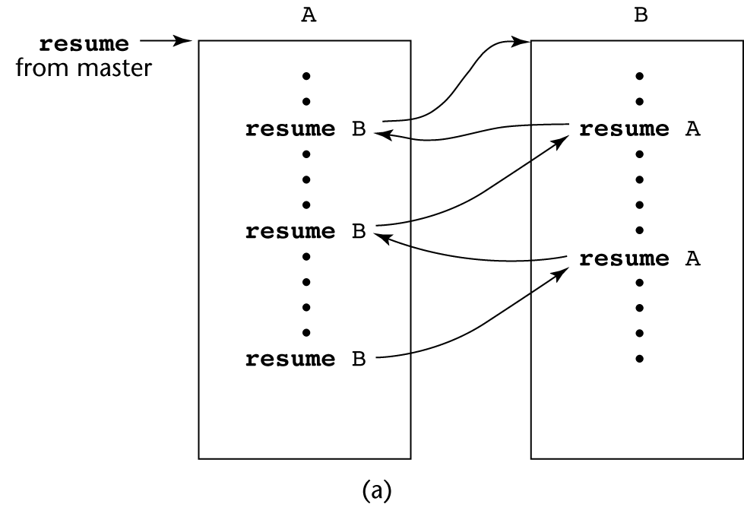
Coroutines Illustrated: Possible Execution Controls

Slide 43
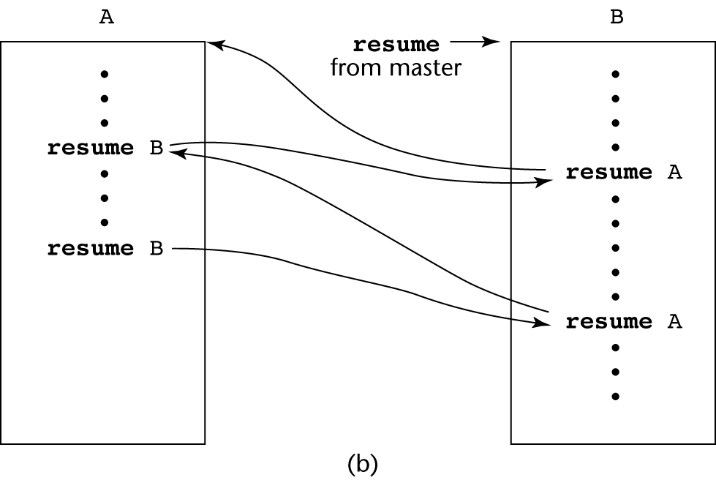
Coroutines Illustrated: Possible Execution Controls

Slide 44
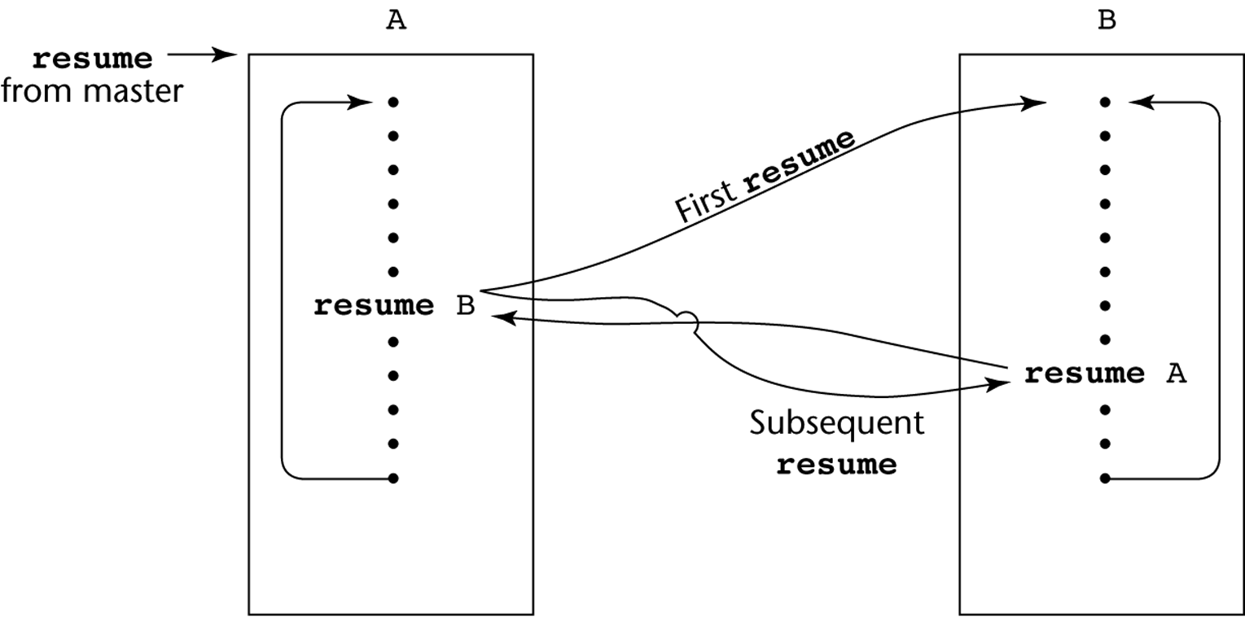
Coroutines Illustrated: Possible Execution Controls with Loops

Slide 45
Summary
A subprogram definition describes the actions represented by the subprogram
Subprograms can be either functions or procedures
Local variables in subprograms can be stack-dynamic or static
Three models of parameter passing: in mode, out mode, and inout mode
Some languages allow operator overloading
Subprograms can be generic
A coroutine is a special subprogram with multiple entries

